Slide 1

From Chaos to Clarity
Our Mission
Connecting the dots..
Clarity and Actionable Insights
Innovative Solutions for Growth
Data-Driven Landscape
Optimize Workflows
Reimagine the Future

Slide 2

Data-Driven Insights
Descriptive Analytics: What has happened?
Diagnostic Analytics: Why did it happen?
Predictive Analytics: What will happen?
Prescriptive Analytics: What should we do?

Slide 3

Customer-Centric Solutions
Deep understanding of client's needs and goals
Tailored solutions for optimal outcomes
Open communication and collaboration
Proactive issue resolution
Dedicated support at every stage

Slide 4

We are Your Partner in Growth
Clarity and Actionable Insights
Innovative Solutions for Growth
Data-Driven Insights
Effective Data Visualization
Data Analytics Expertise

Slide 5

Real-Time Analytics
Up-to-the-second insights
Instant decision-making
Proactive issue resolution
Enhanced customer experiences
Optimized operational efficiency

Slide 6

Effective Data Visualization
Tools to present data in a clear, concise, and compelling manner
Interactive dashboards
Reports
Charts
Graphs

Slide 7
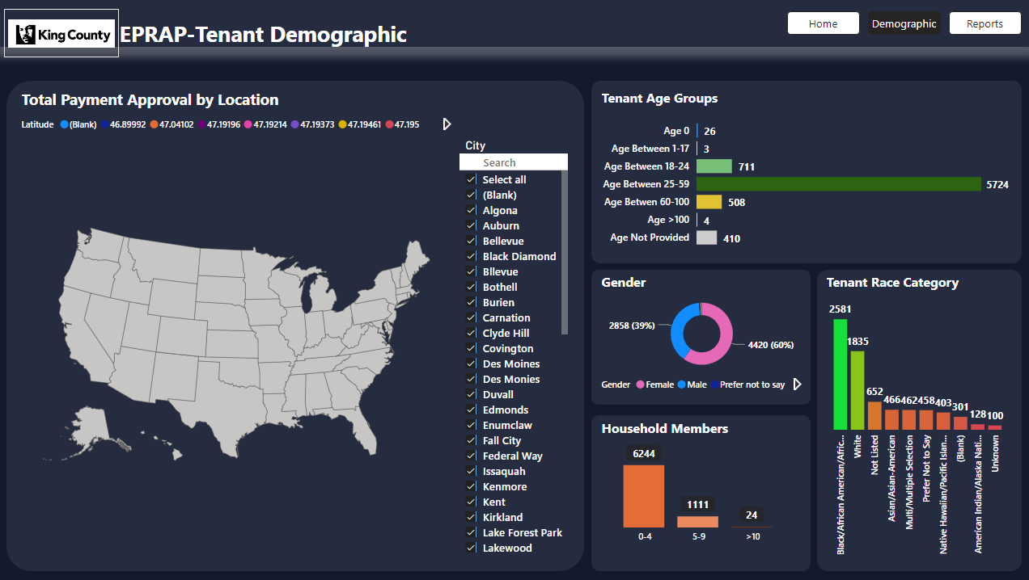
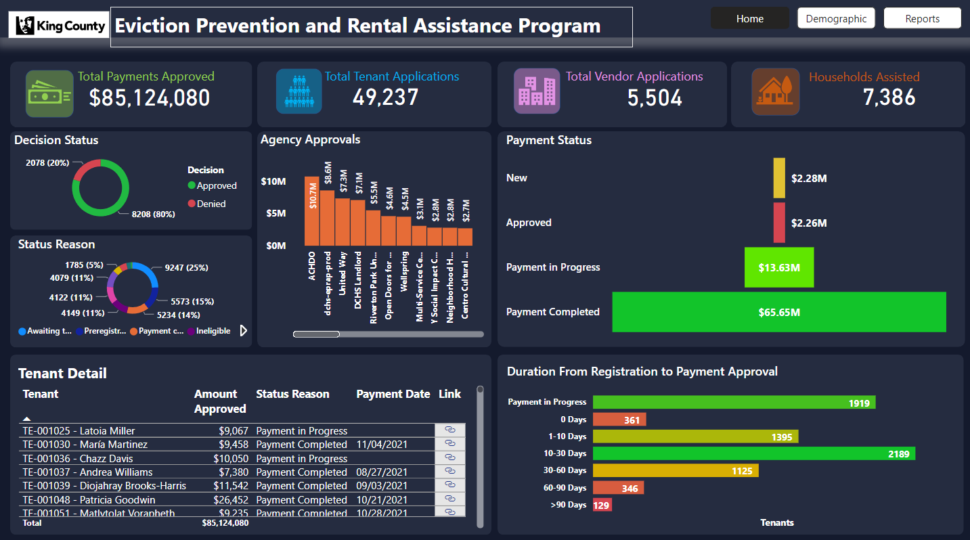
King County Case Study
Key Metrics: $85.1M approved payments, 49,237 tenant applications, 7,386 households assisted.
Decision Efficiency: 80% approval rate, denial tracking, agency fund distribution analysis.
Demographic Intelligence: Beneficiaries 25-59, 60% female, diverse racial representation.
Process Optimization: Payment tracking ($65.65M completed), duration tracking.
Actionable Outcomes: Real-time fund monitoring, targeted outreach, efficiency improvements.

Slide 8
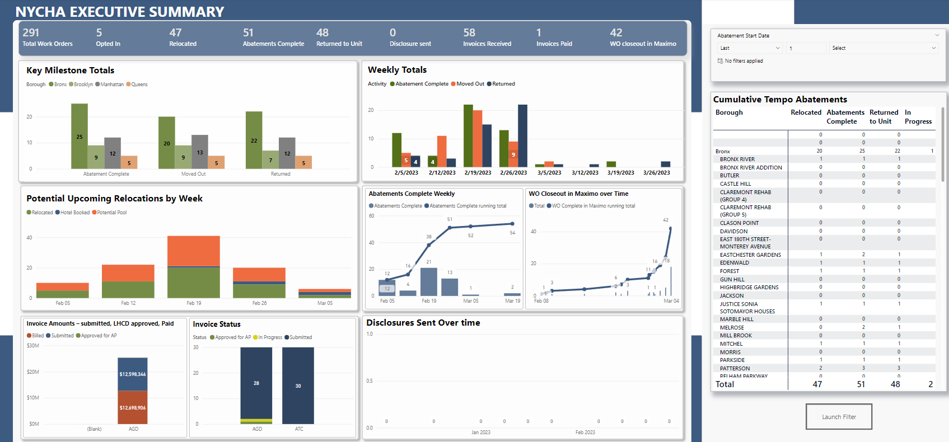
NYCHA Operations Analysis - Success Story
NYCHA Operations Analysis (Feb - Mar 2023)
291 Work Orders, 51 Abatements (17.5%)
47 Cases Relocated, 42 Work Orders Closed
Bronx: 25 Completed Units, Peak Activity Week of 2/19/23
$12.5M Invoices Approved, 58 Received, 1 Paid
Streamline Invoice Processing, Scale Bronx Model, Improve Financial Efficiency

Slide 9

Transforming Insights into Solutions
Service Portfolio: Packaged service offerings based on presented capabilities.
Targeted Marketing: Content and materials tailored to specific client needs.
Value Proposition: Clear articulation of benefits and ROI.
Case Study Showcase: Demonstrate successful client engagements and outcomes.
Thought Leadership: Establish LBC as industry experts through publications, webinars, etc.

